Slide 1
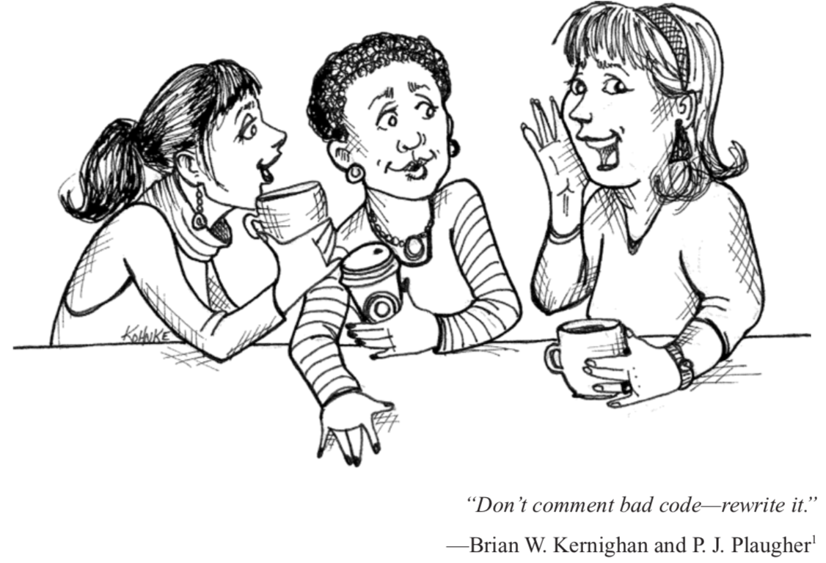
Clean Code
4.Comments

Slide 2
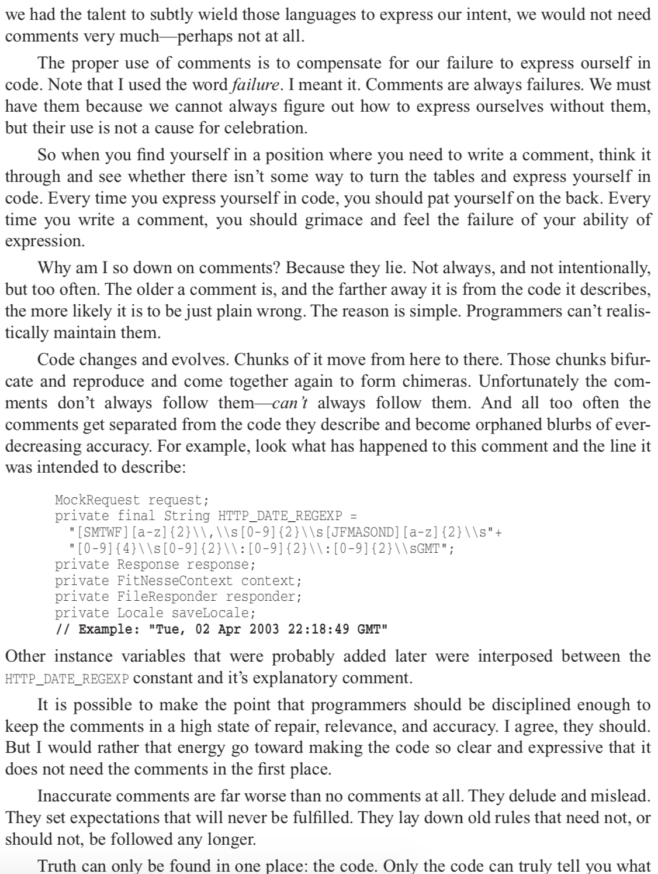
注释只是糟糕代码的一个补救措施
我们要首先思考的是如何把我们的代码弄干净
因为只有代码是最忠诚的，它不会撒谎。
清晰的逻辑和见名知意的代码，
永远用比大段的注释更具有表达力。

Slide 3
Comments Do Not Make Up for Bad Code Explain Yourself in Code
// Check to see if the employee is eligible for full benefits
if ((employee.flags & HOURLY_FLAG) && (employee.age > 65))
if (employee.flags)
if (employee.flags & HOURLY_FLAG)
Or this ?
if (employee.isEligibleForFullBenefits())
if ((employee.flags & HOURLY_FLAG) && (employee.age > 65))

Slide 4
good comment is the comment you found a way not to write.

Slide 5
But

Slide 6
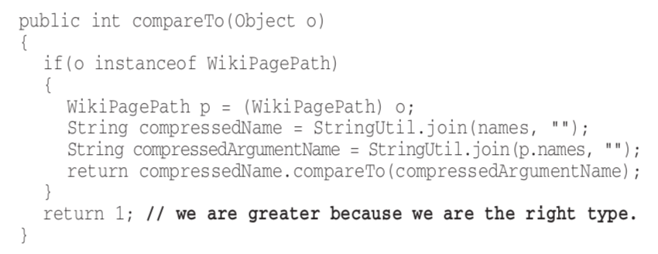
Good Comments
Legal Comments 法律信息
// Copyright (C) 2003,2004,2005 by Object Mentor, Inc. All rights reserved. // Released under the terms of the GNU General Public License version 2 or later.
Informative Comments 提供信息的注释
// format matched kk:mm:ss EEE, MMM dd, yyyy
Pattern timeMatcher = Pattern.compile( "\\d*:\\d*:\\d* \\w*, \\w* \\d*, \\d*");
Explanation of Intent 解释意图

Slide 7
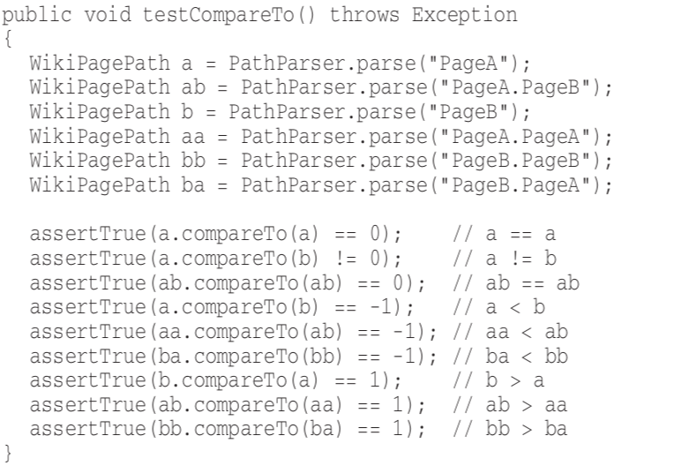
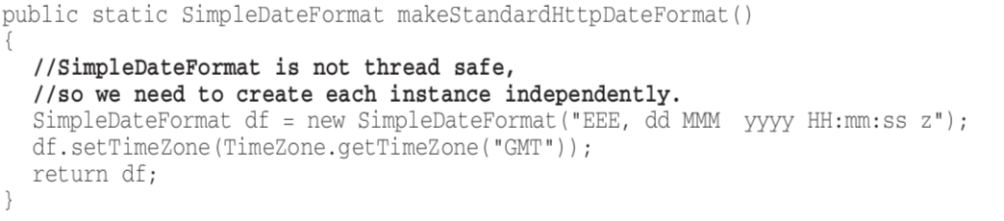
Good Comments
Clarification 阐释含义
Warning of Consequences 警示

Slide 8
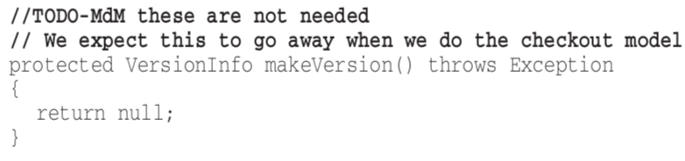
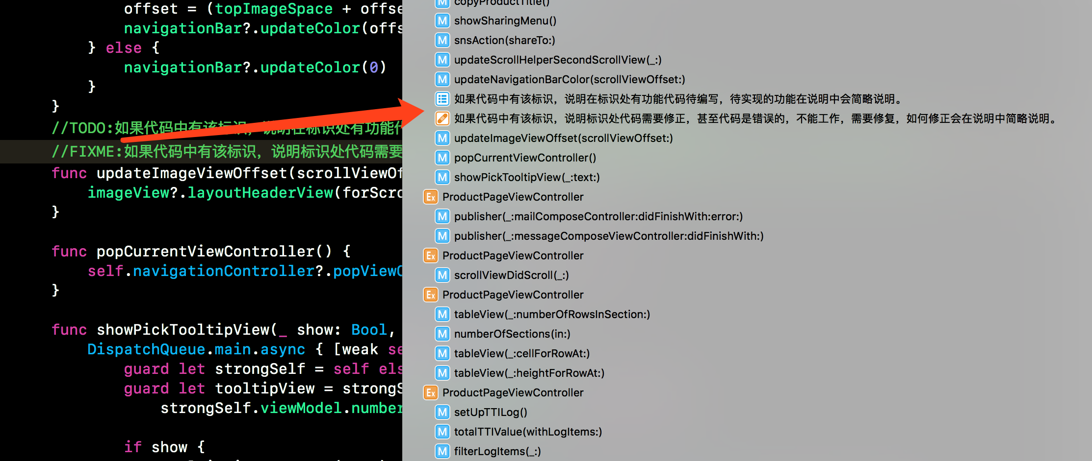
Good Comments
TODO Comments

Slide 9
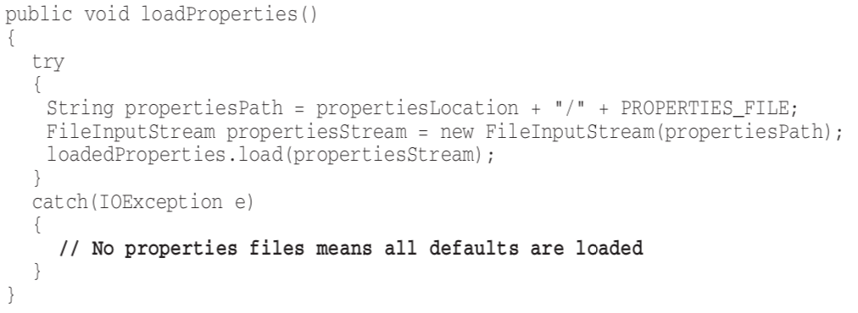
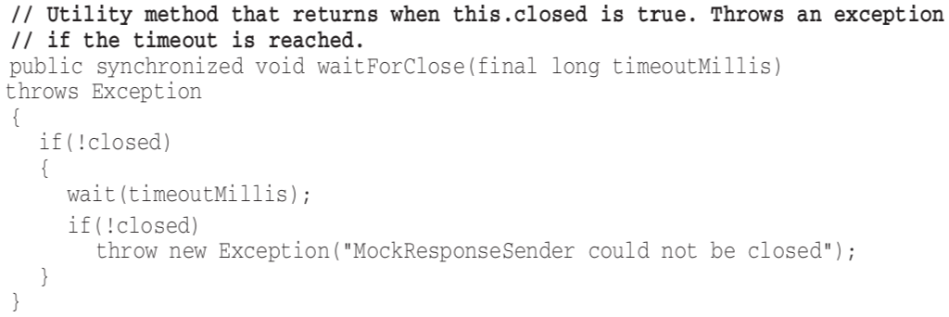
Bad Comments
Mumbling 自说自话
Redundant Comments & Misleading Comments 多余和误导的注释

Slide 10
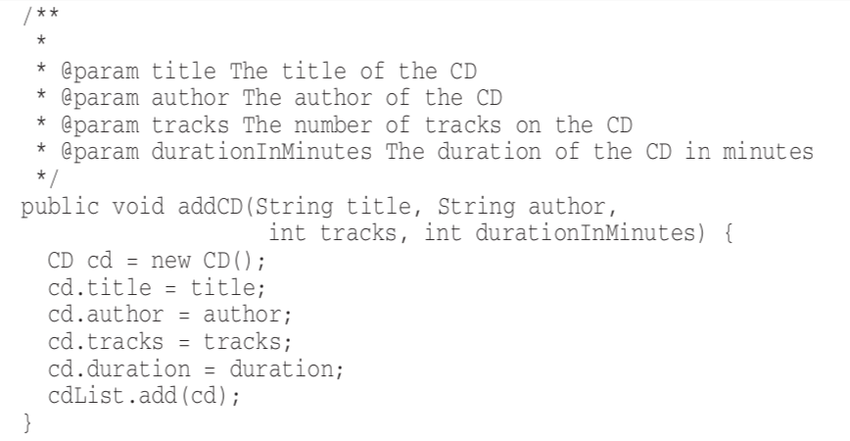
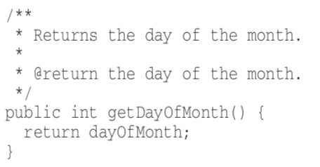
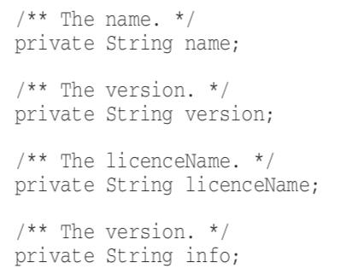
Bad Comments
Mandated Comments 循环式注释
Noise Comments 废话

Slide 12
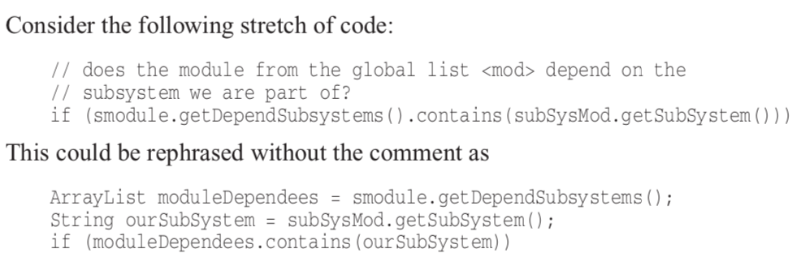
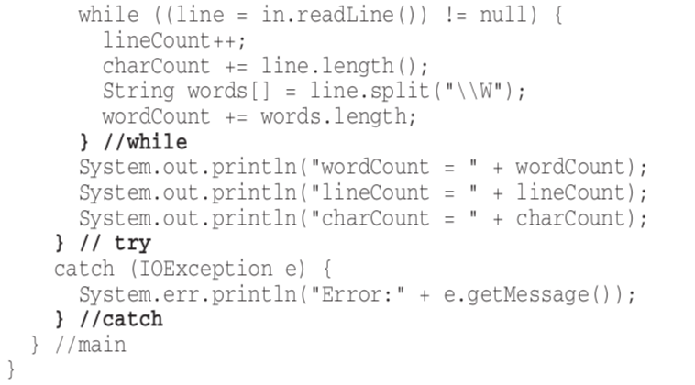
Bad Comments
Don’t Use a Comment When You Can Use a Function or a Variable 能用函数说明就不要用注释
Closing Brace Comments 括号后面的注释

Slide 13
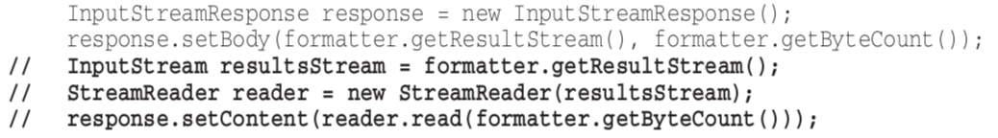
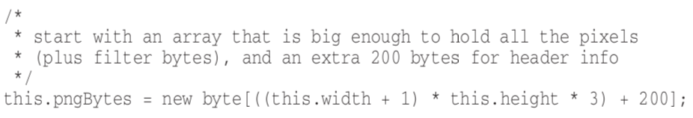
Bad Comments
Commented-Out Code 注释代码
HTML Comments HTML 注释
Nonlocal Information 非本地信息
Too Much Information 信息过多
Inobvious Connection 不明显的联系

Slide 14
Google 开源项目风格指南
你见过哪些奇趣的代码注释？
What is the best comment in source code you have ever encountered?

